Slide 1
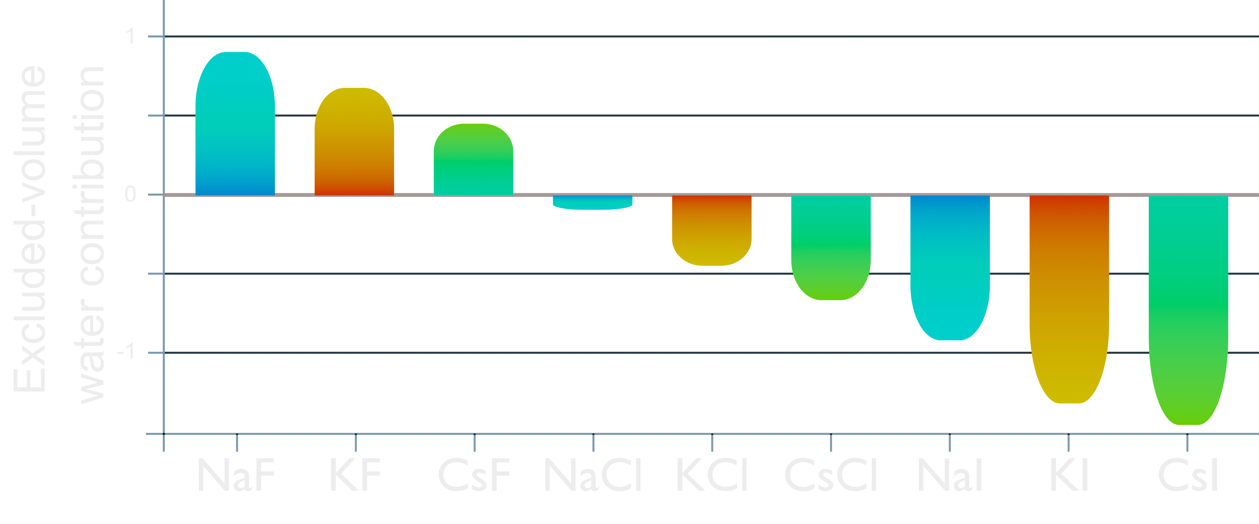
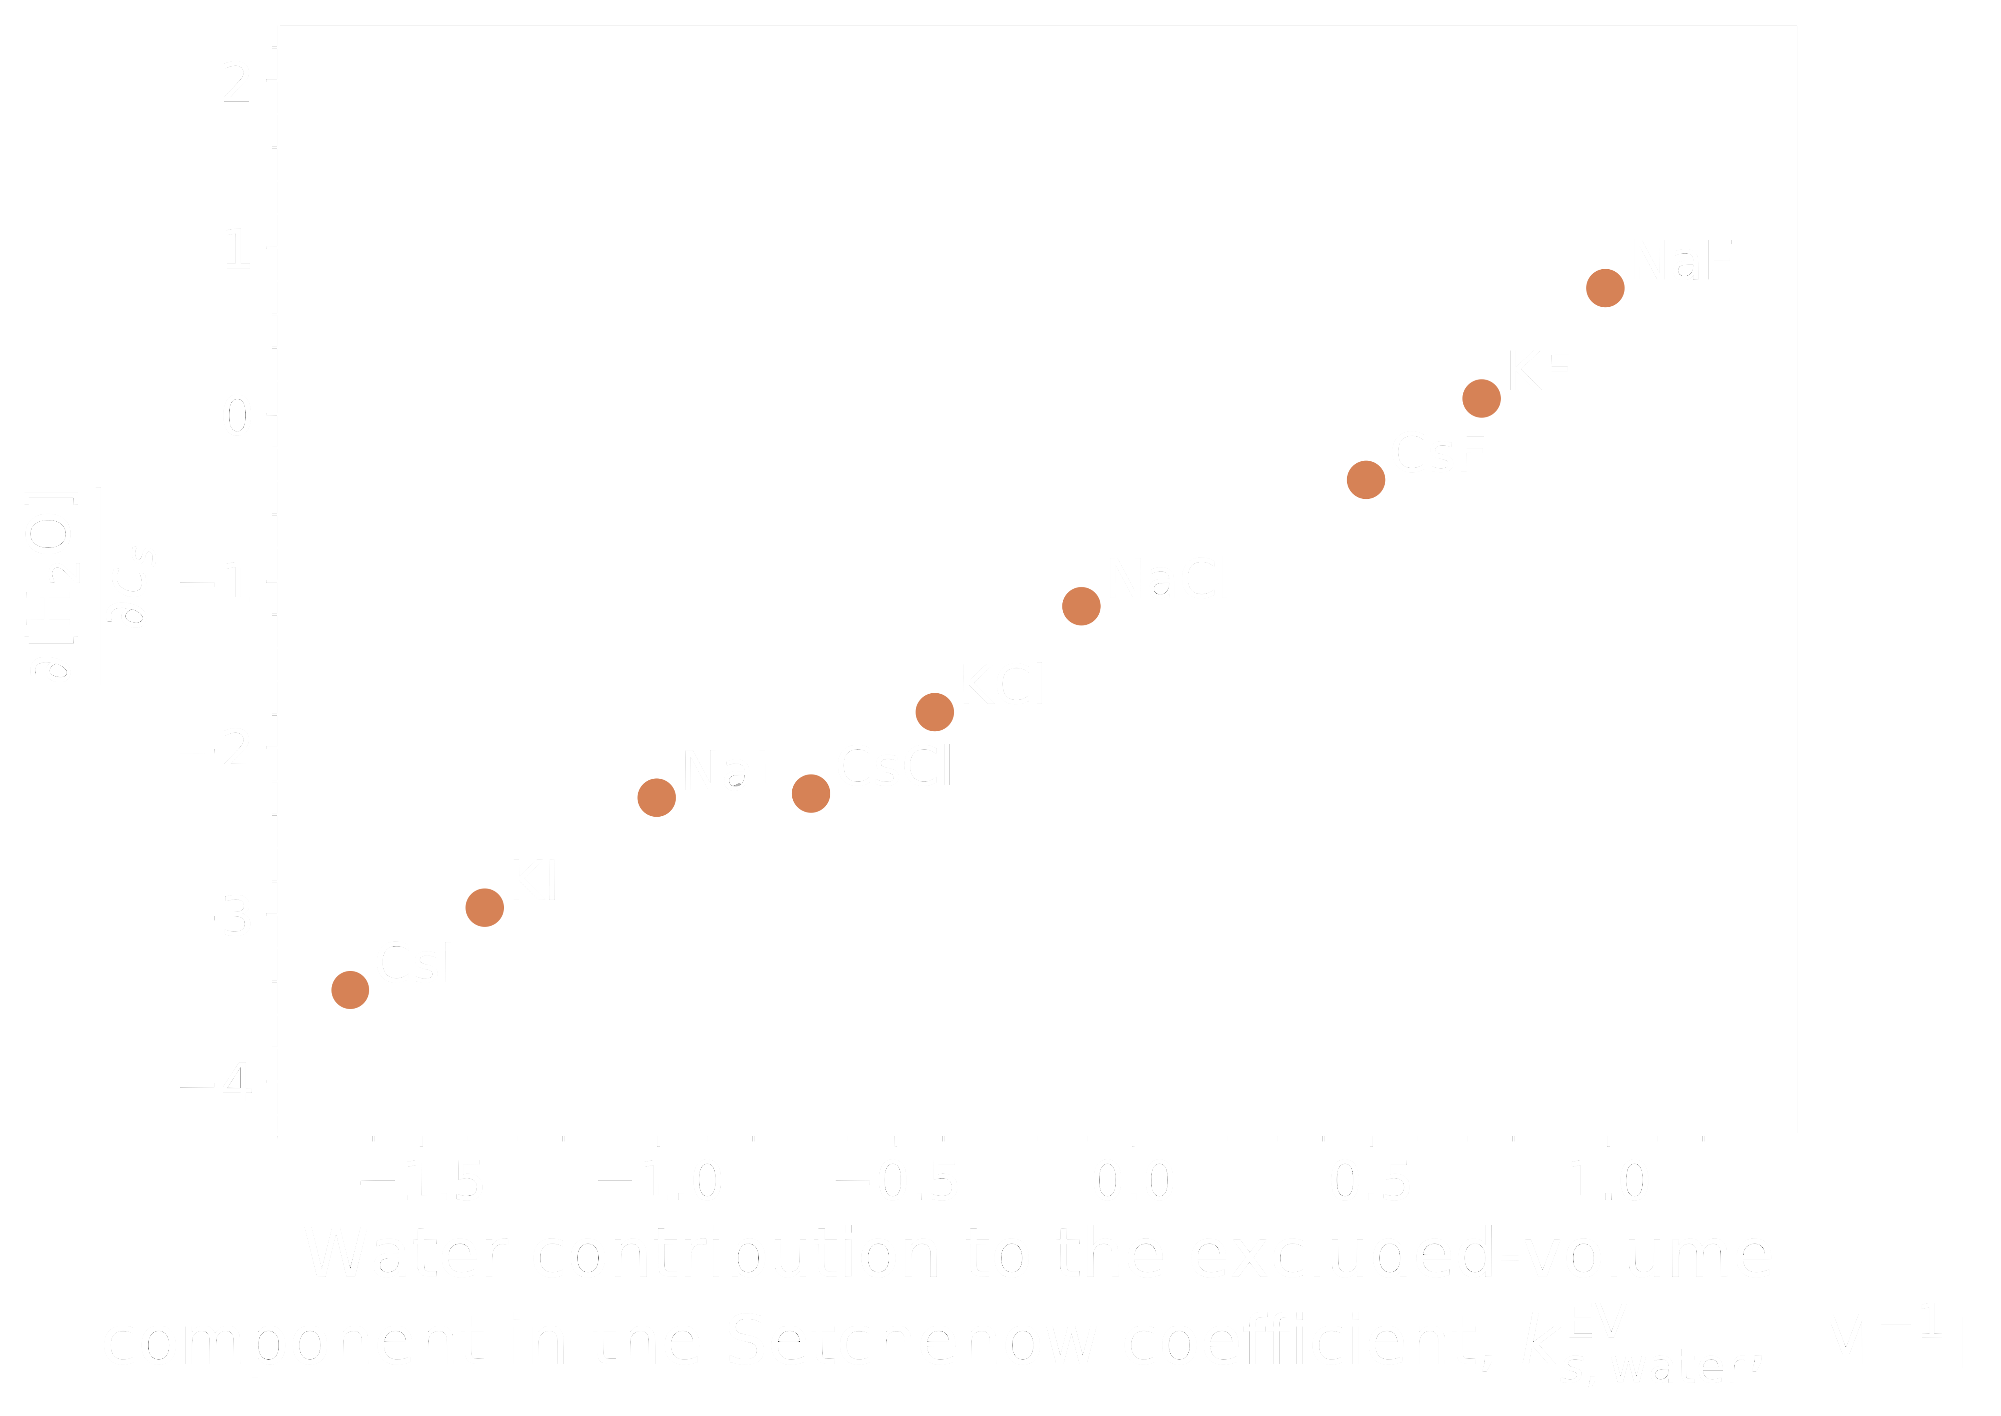
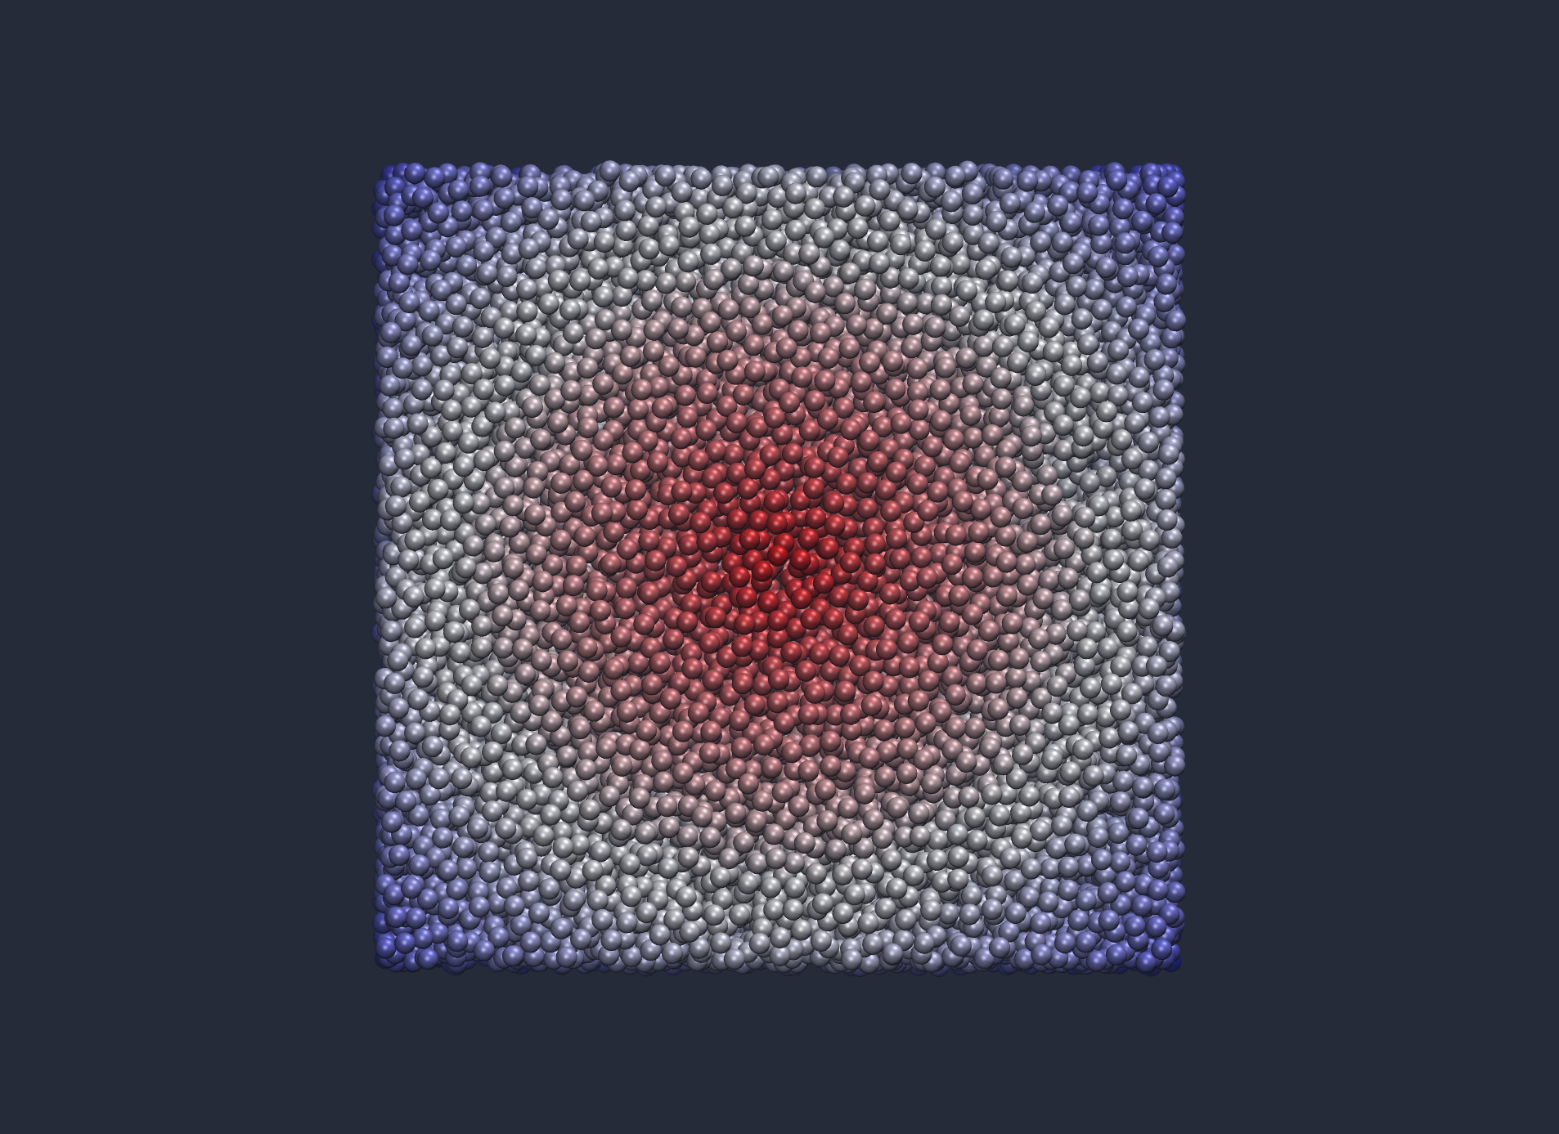




ANION-CATION CONTRAST IN SOLUTE SOLVATON
THE EFFECT OF WATER
Dr. Stefan Hervø-Hansen, Dr. Kento Kasahara , Dr. Nobuyuki Matubayasi
Graduate school of Engineering Science, Osaka University
Background
Water is a truly remarkable liquid substance in our world due to its striking properties ensuring life on earth as we know it and setting it side from other liquids. For this reason water is indubitably the most studied liquid ever. Since the early 1900s the ion attributes chaotropic and kosmotropic has been used to label ions’ electrostrictive effect to either increase or decrease the mean water density compared to that of neat water. Forward to the year 2003, the paper ”Negligible effects of ions on the hydrogen bond structure in liquid water” was published in Science. This strongly divided the scientific community, causing the water-(dis)ordering theory to fall into obscurity with instead the theory of preferential accumulation or exclusion to become more a dominant theory.
Question
How does salt act as either a chaotrope or kosmotrope in the solvation of small solutes and over how many solvation shells are the energetics affected?
Main findings
Free energy calculations reveal the classic Hofmeister ordering of anions and cations in water’s contribution to the solvation free energy with negative values being chaotropic salts and positive values being kosmotropic salts.
Kosmotropic
Chaotropic
Data
In agreement with experimental volumetric measurements the concentration of water is either increased or deceased by salt and correlates well with the excluded-volume component of water.
How many solvation shells are energetically affected will be answered in the near future by RDF conditional solvation free energy calculations…
S3
S2
S1
Methodology
The difference in excluded volume contribution arising from water is independent of the solute and theoretically only depends on the type of salt and water model. However in our work we have employed various solutes such as caffeine, n-alkanes, and n-alcohols.
The difference in water excluded volume contribution to the Setschenow coefficient, k_{s}^{EV}
Here is a function which includes the pair-energy and indirect part of the potential of mean force.

